Slide 1
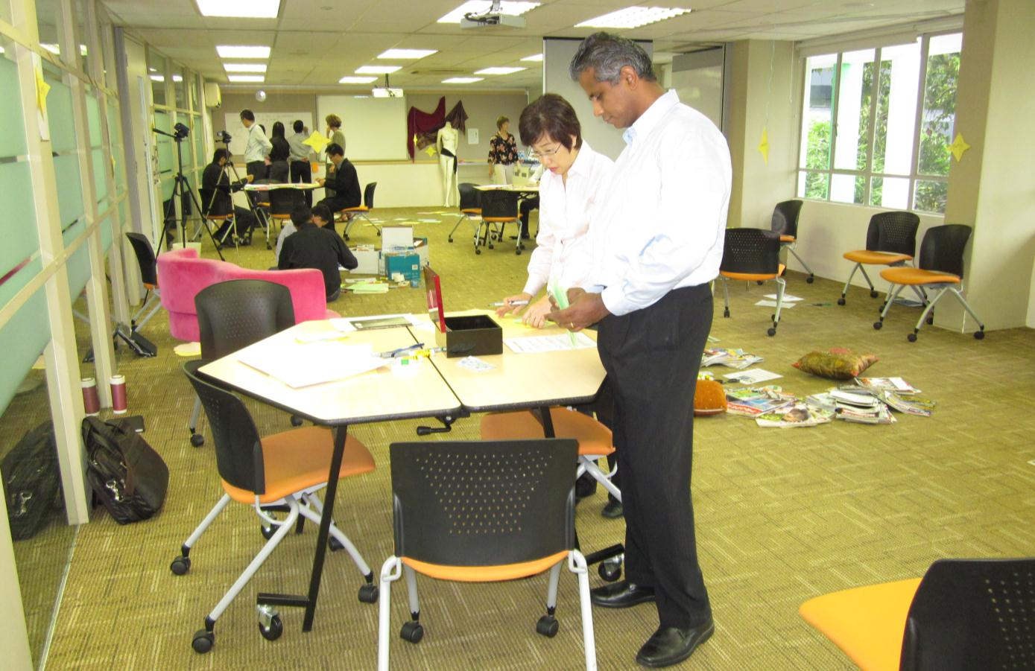
Who are we as teachers?
Ecology Room Activities
From The “Who” of Teaching workshop for trainers
Run by Dr Sue Stack and Renee Tan
Institute for Adult Learning, Singapore
November 2011

Slide 2
The challenge:
To create an experience for trainers:
To reflect on aspects of their practice, making the tacit explicit
To help create new conversations about what we value
To help build up a deeper understanding of the being and becoming of a teacher/trainer.

Slide 3
Principles of the ‘ecology room’
The ecology room aims to allow participants to go on their own journey through different activities that help them access their holistic intelligences. People are encouraged to interact, and comment on each others’ artefacts through using post-it notes.
The activities are carefully juxtaposed to enable:
  diversity - multiple ways of knowing and experiencing
  redundancy and dissonance
  liberating constraints
  decentralised control
  energy flow and iteration
  metaphors
  feedback
  debriefing and reflecting

Slide 4
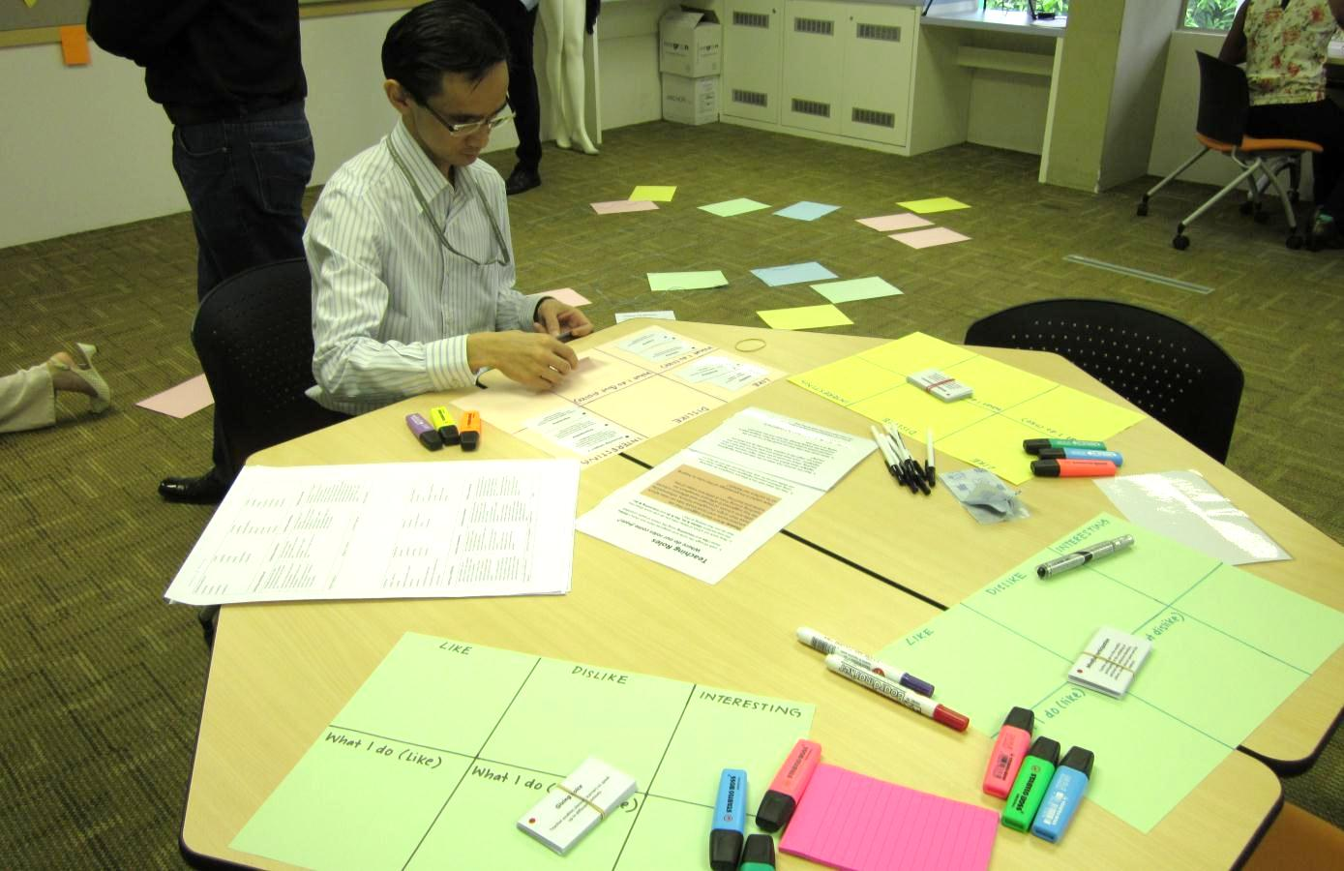
Look at the cards with teaching roles.
Which ones do you like, dislike?

Slide 5
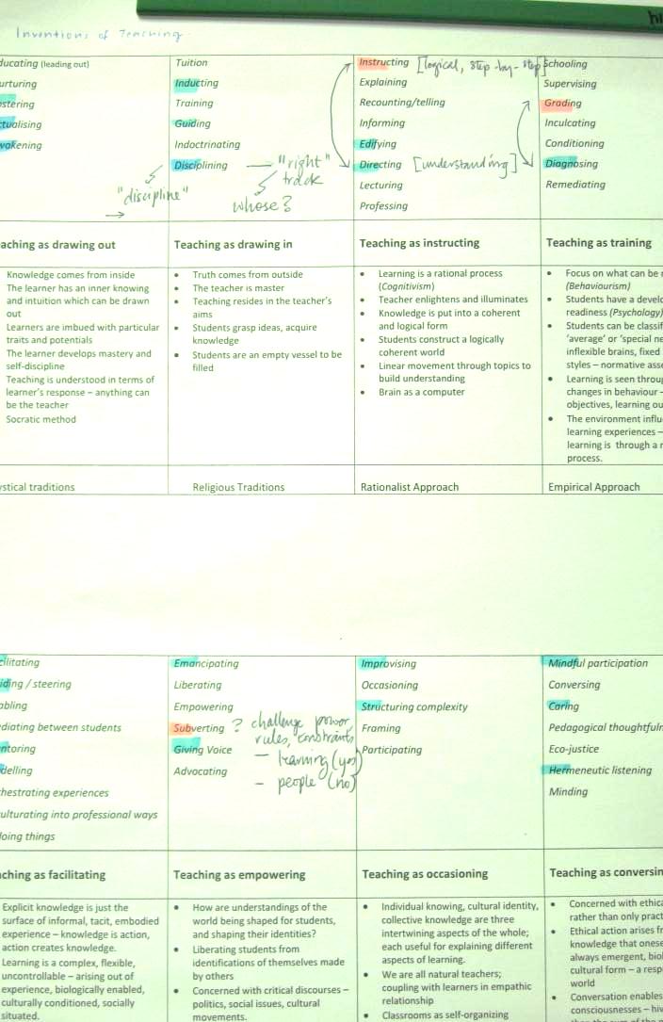
Preferred roles in blue.
Disliked roles in pink.
Now consider the paradigms and beliefs behind these roles.

Slide 6
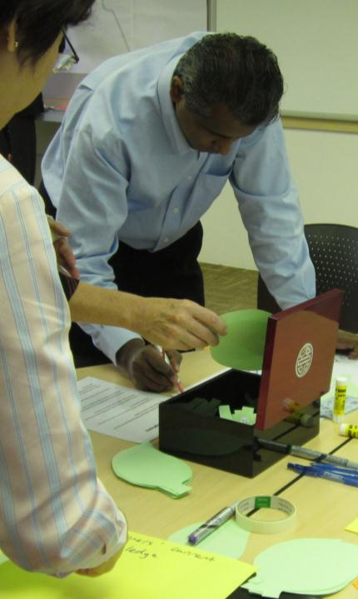
Take an assumption out of the box and consider an opposite

Slide 7
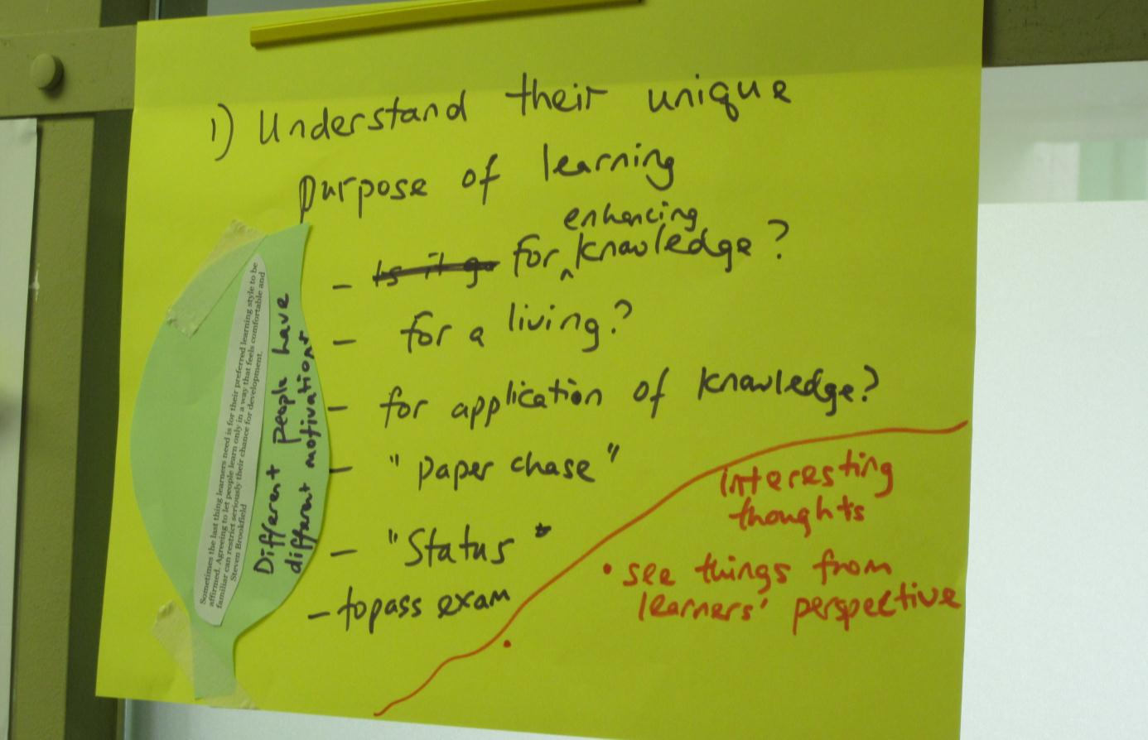
Turning around assumptions

Slide 8
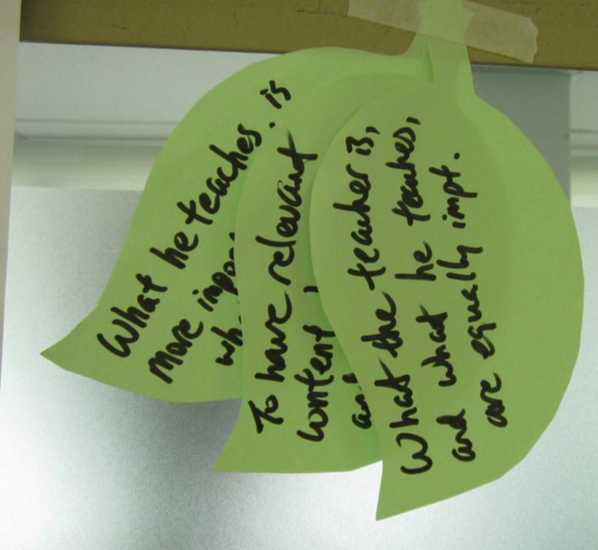
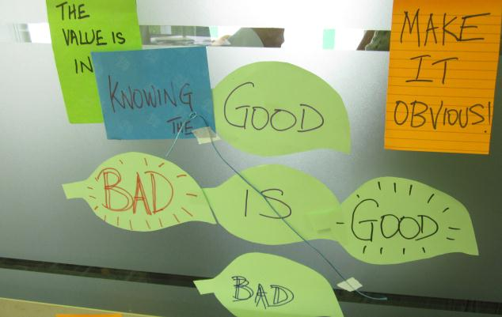
Un-thinking?

Slide 9
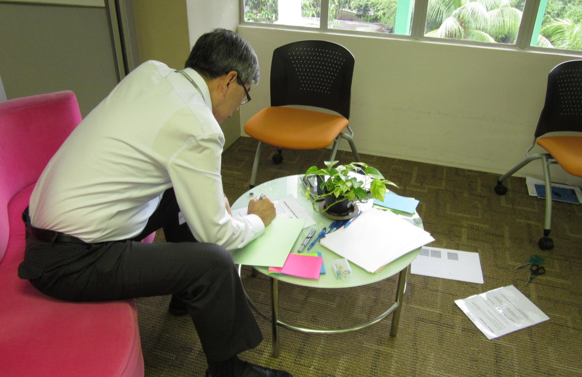
Write about an incident that has stayed with you

Slide 10
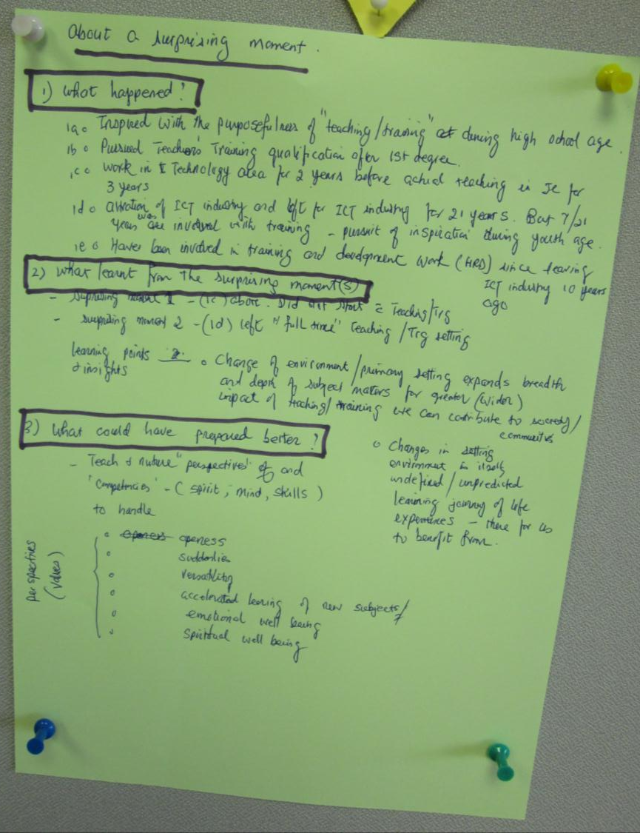
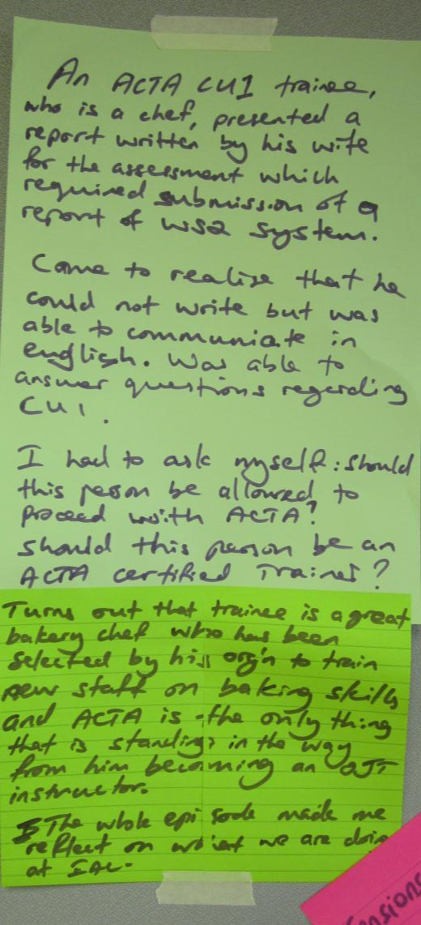

Slide 11
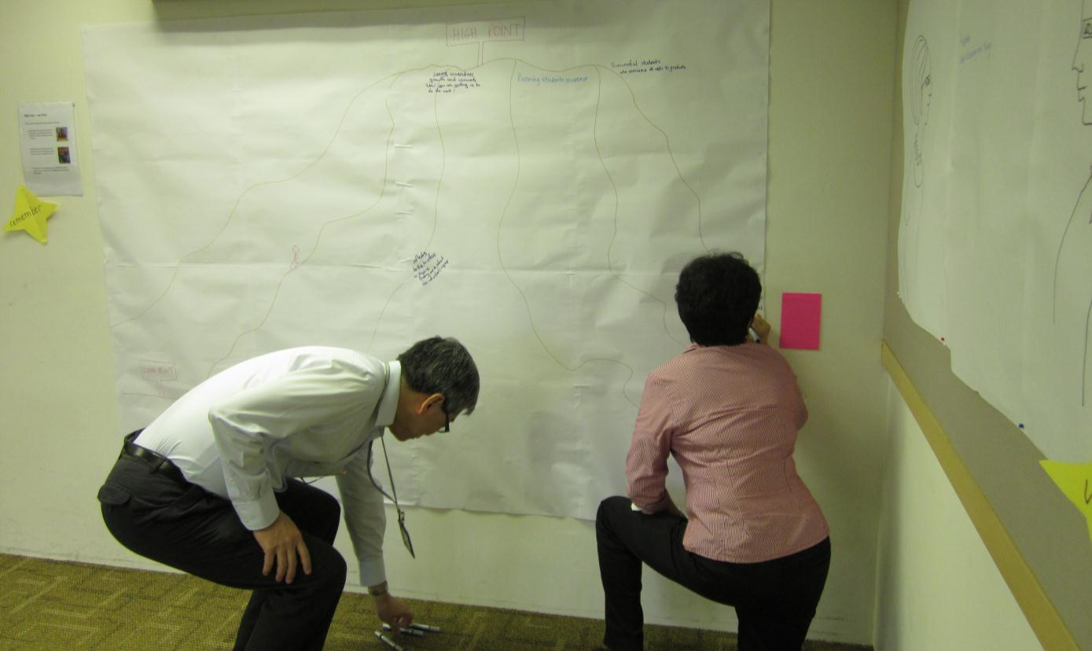
What are your highlights and lowlights on your journey to become a teacher?
What helped you overcome the low points?

Slide 12
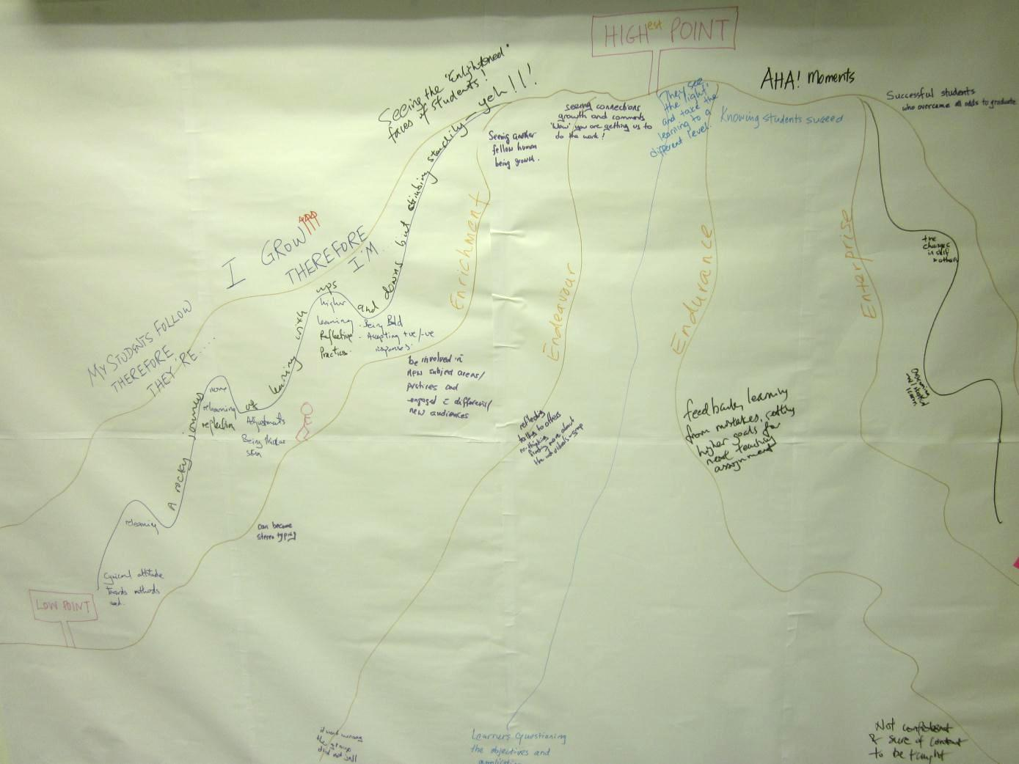
What are your highlights and lowlights on your journey to become a teacher?
What helped you overcome the low points?

Slide 13
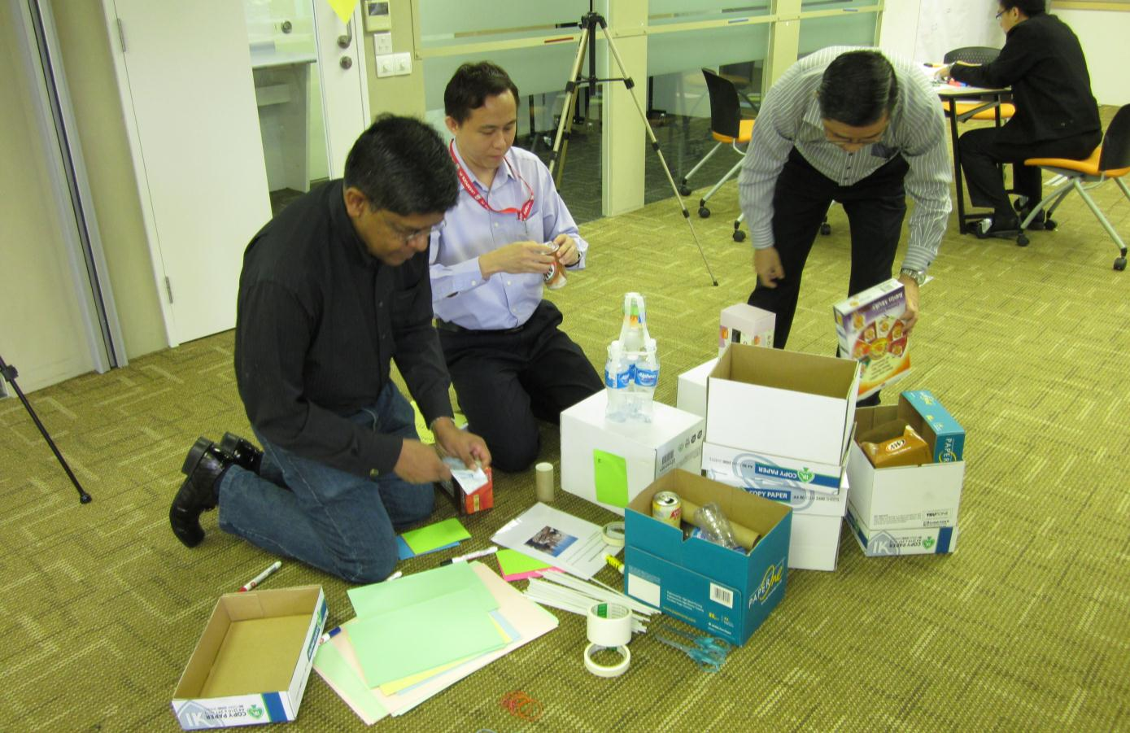
How would you represent the system and the constraints you are facing?

Slide 14
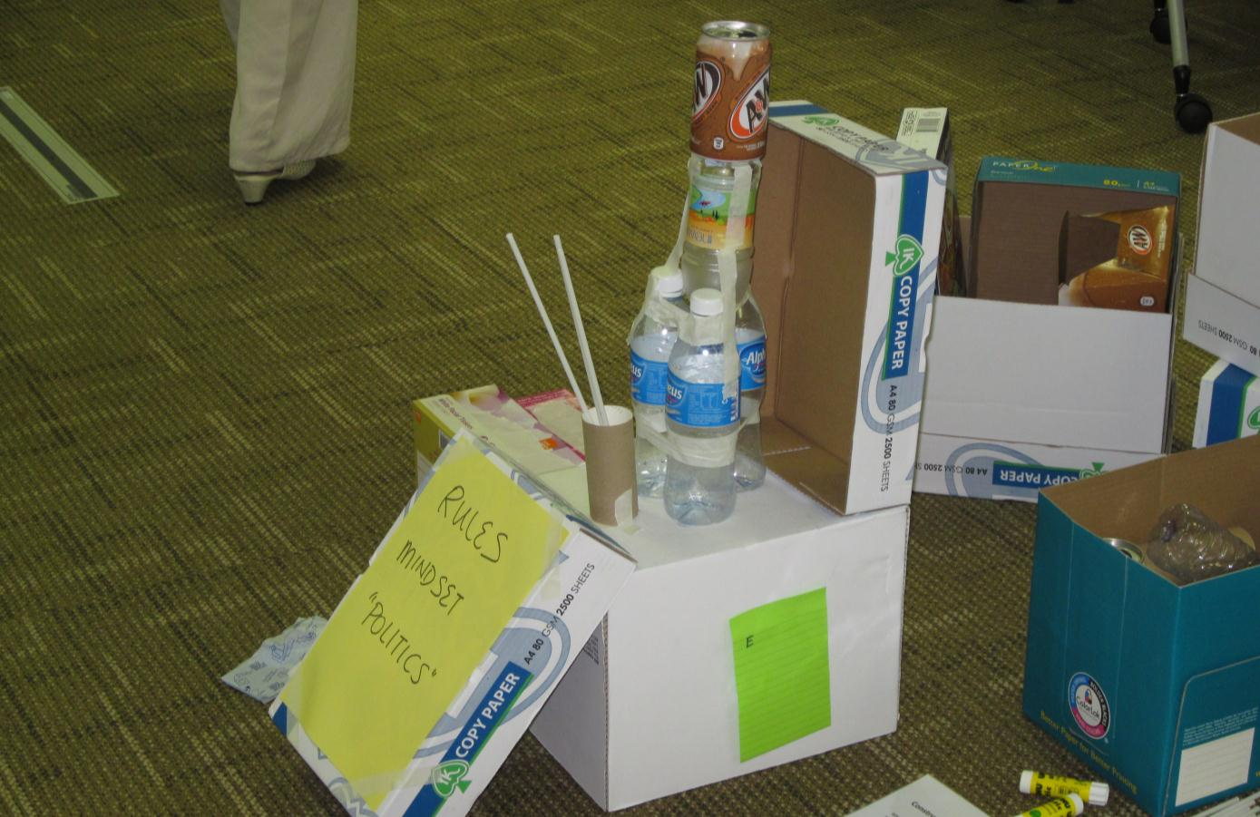
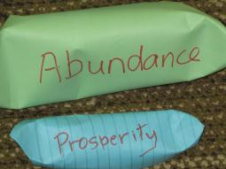
How do you represent the system?

Slide 15
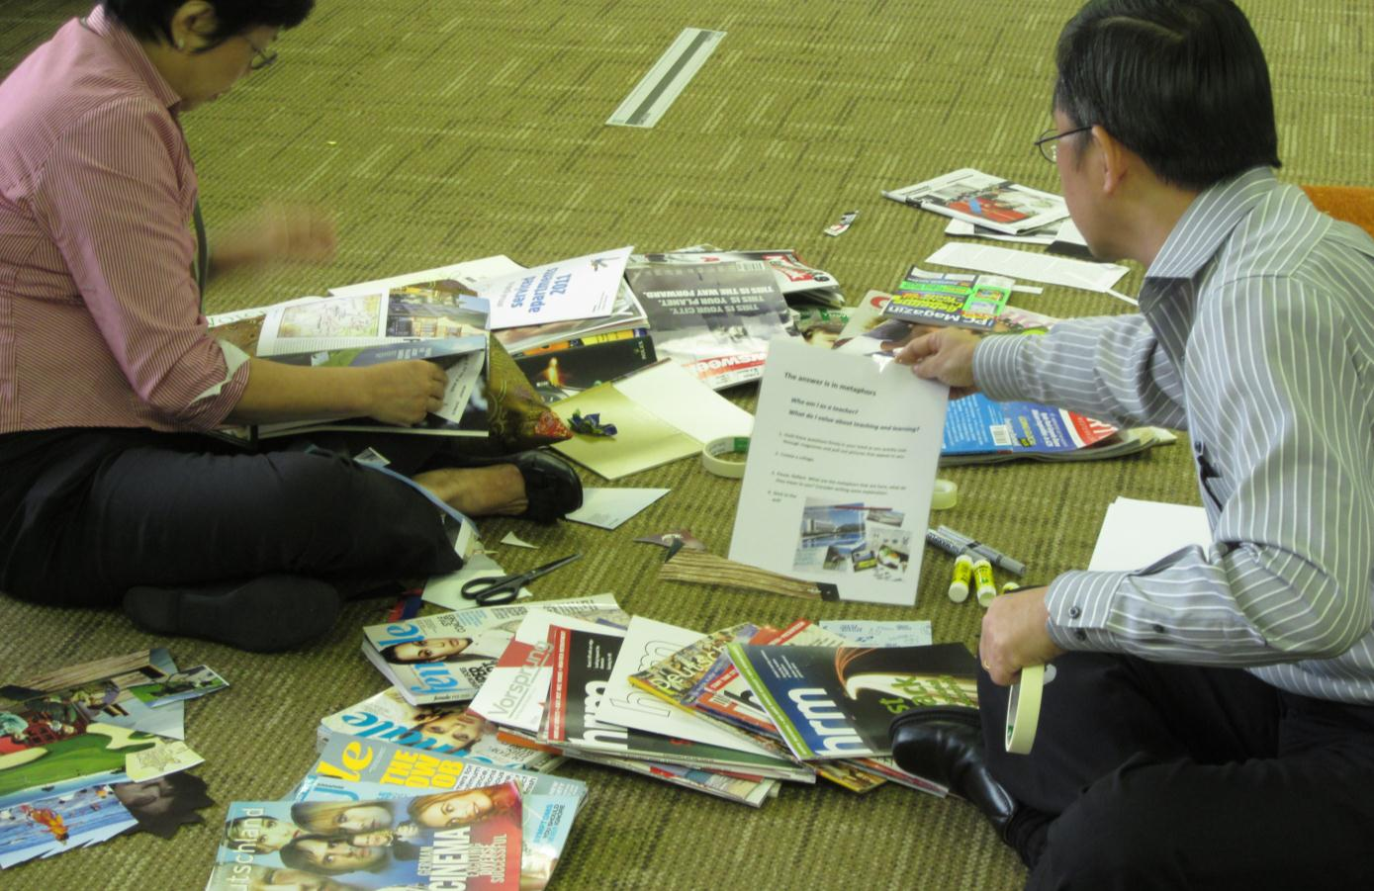
Who am I as a teacher? Choose pictures that help you answer this question.

Slide 16
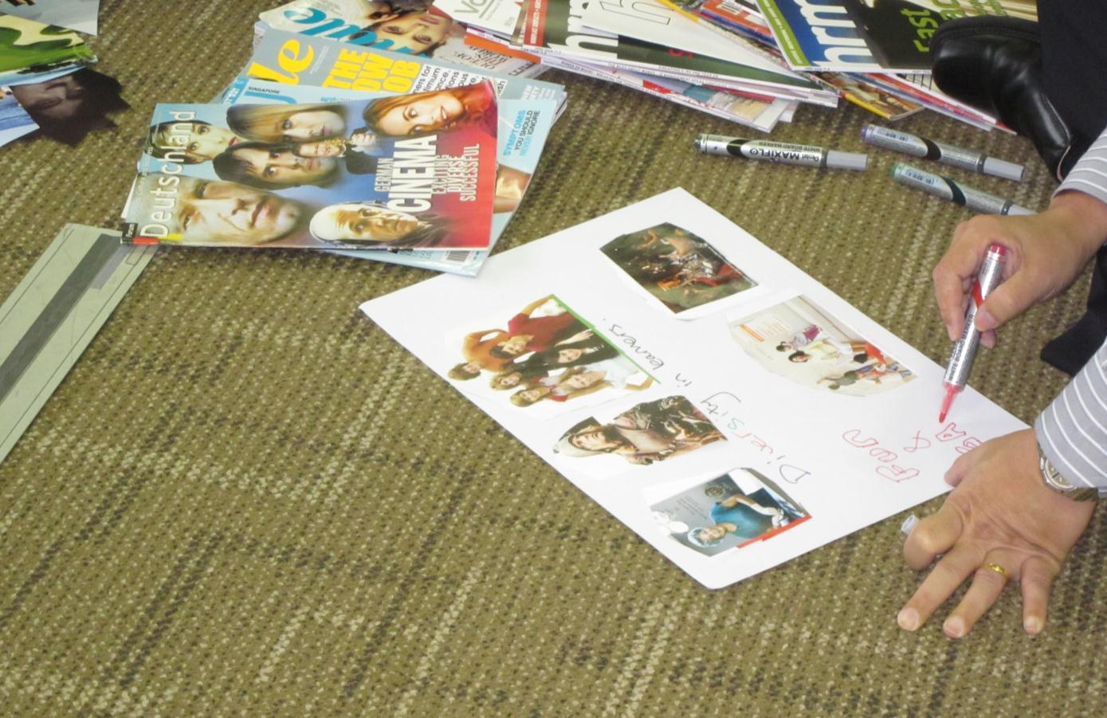
Who am I as a teacher?

Slide 17
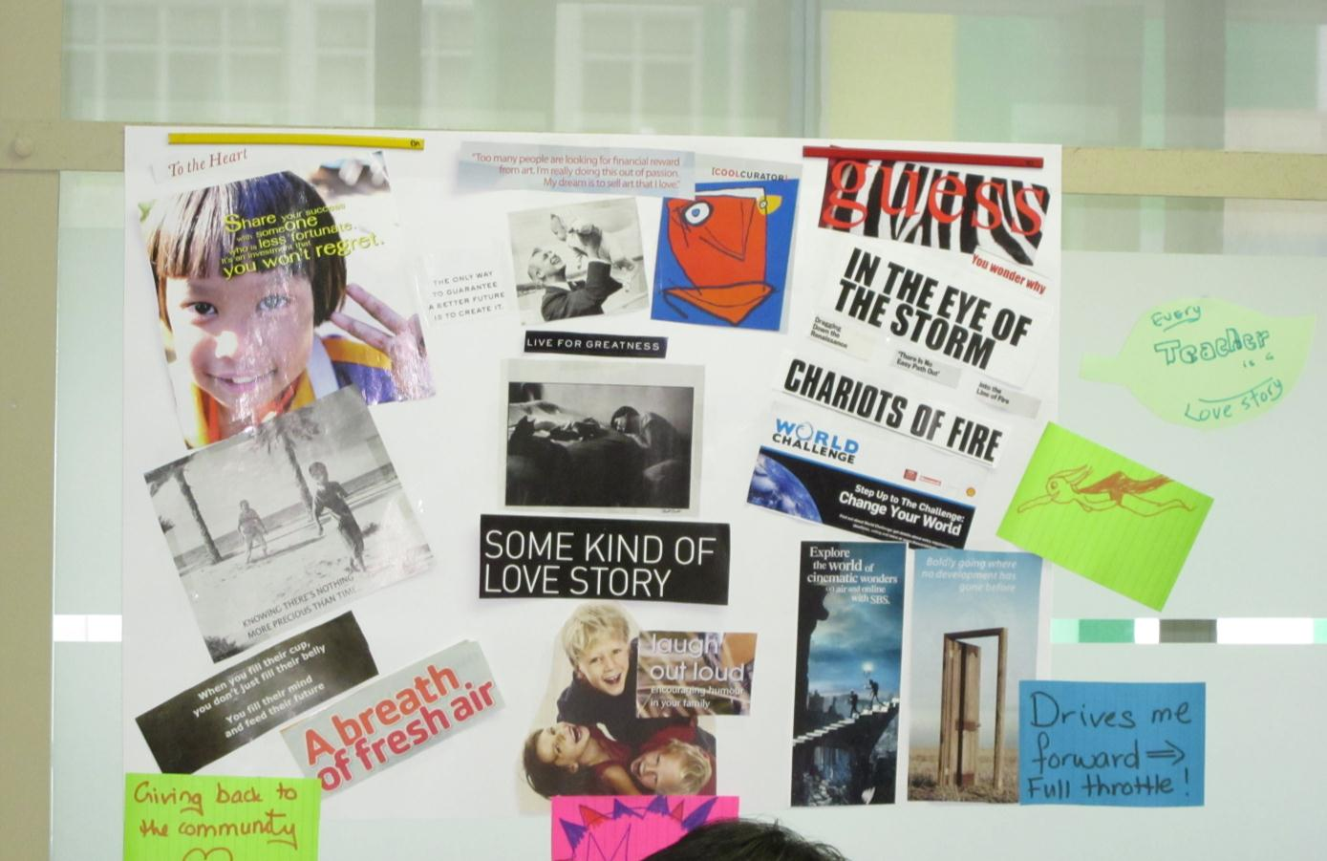
Who am I as a teacher?

Slide 18
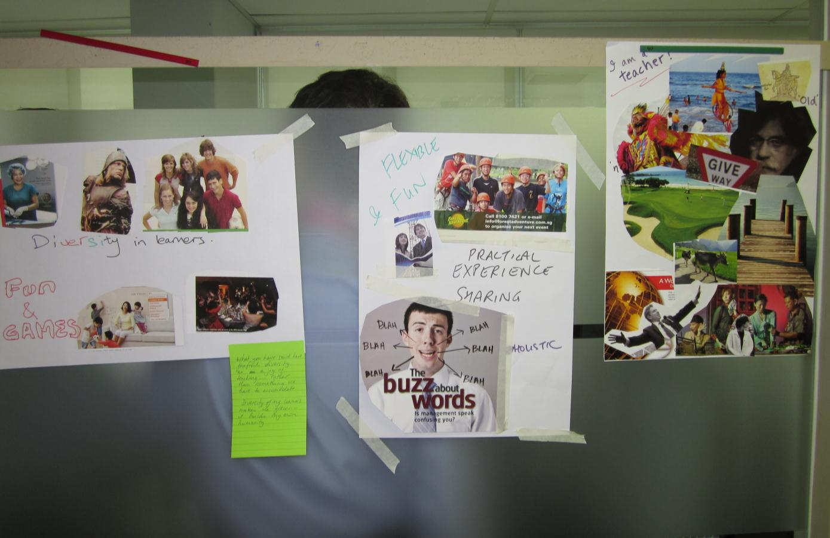
Who am I as a teacher?

Slide 19
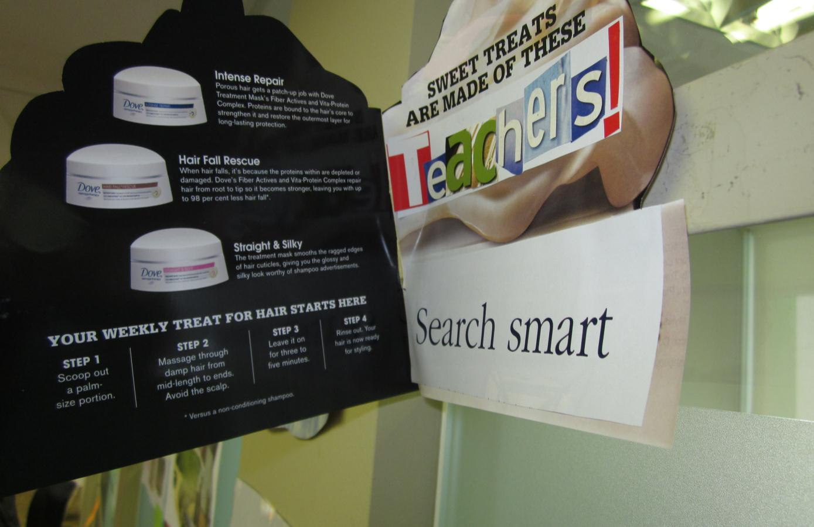
Who am I as a teacher?

Slide 20
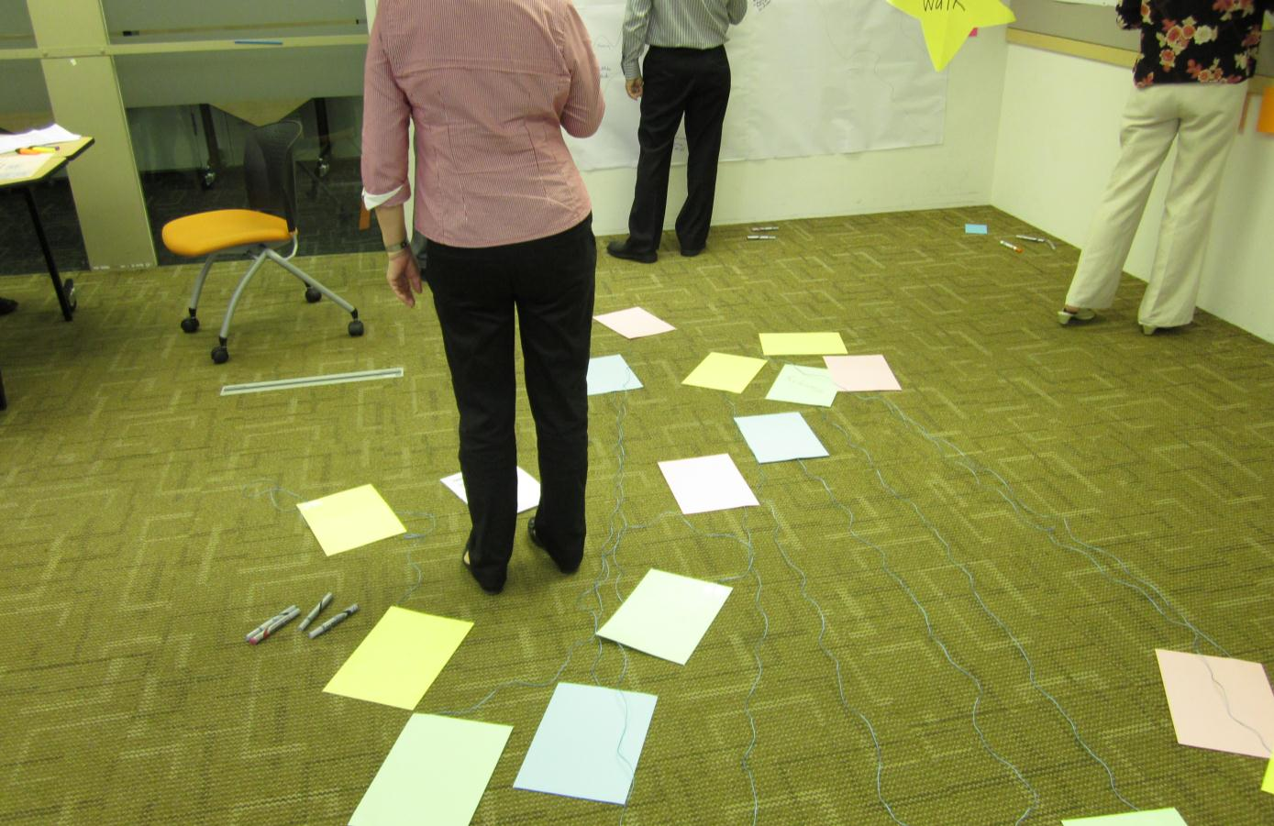
What are the tensions that you are experiencing?

Slide 21
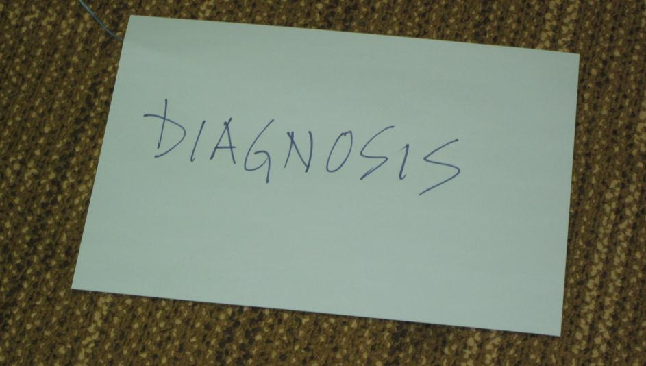
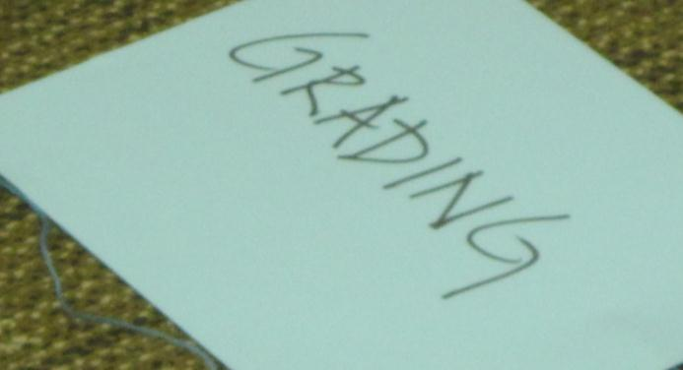
What are your tensions?

Slide 22
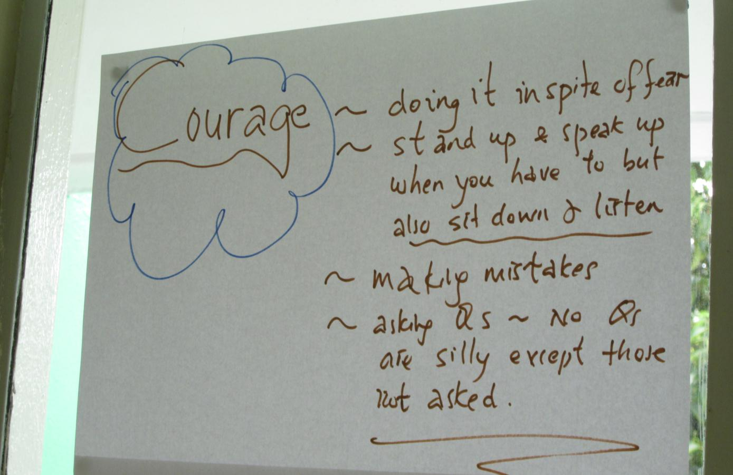
Consider a past mentor or teacher that you admire.
What qualities did you value?

Slide 23
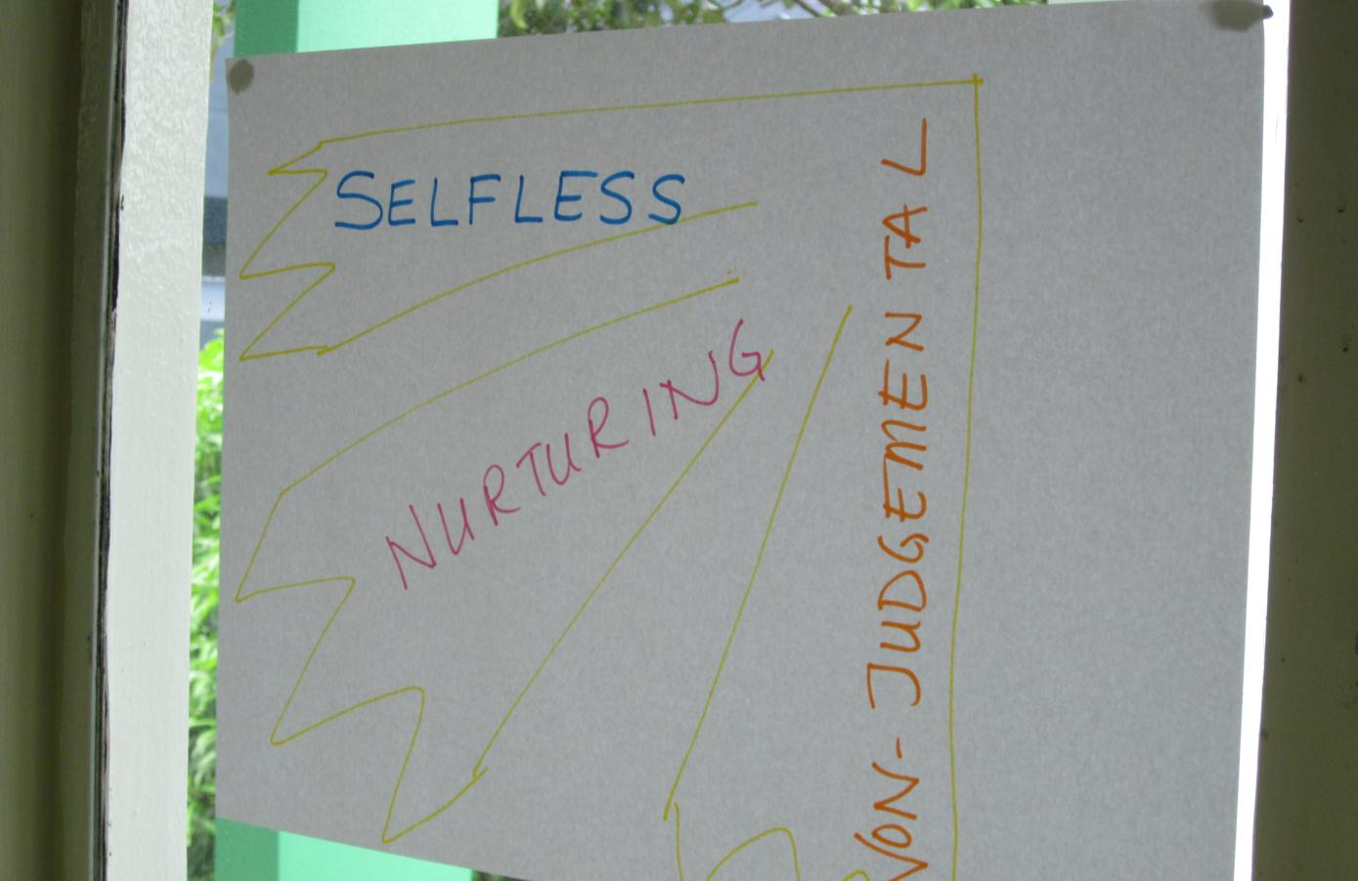
Consider a past mentor or teacher that you admire.
What qualities did you value?

Slide 24
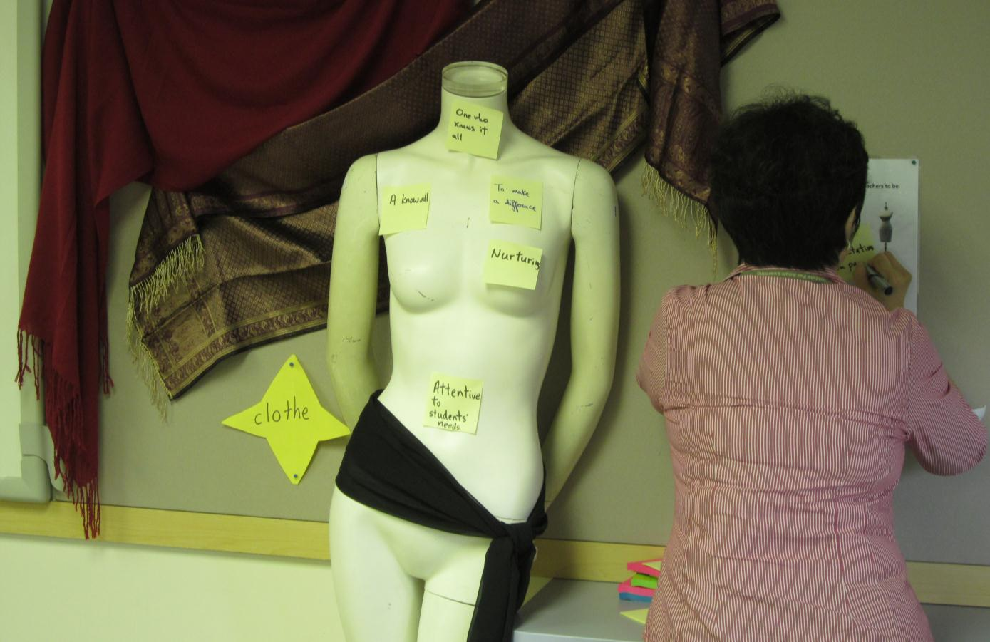
What are the expectations that others have about teachers?

Slide 25
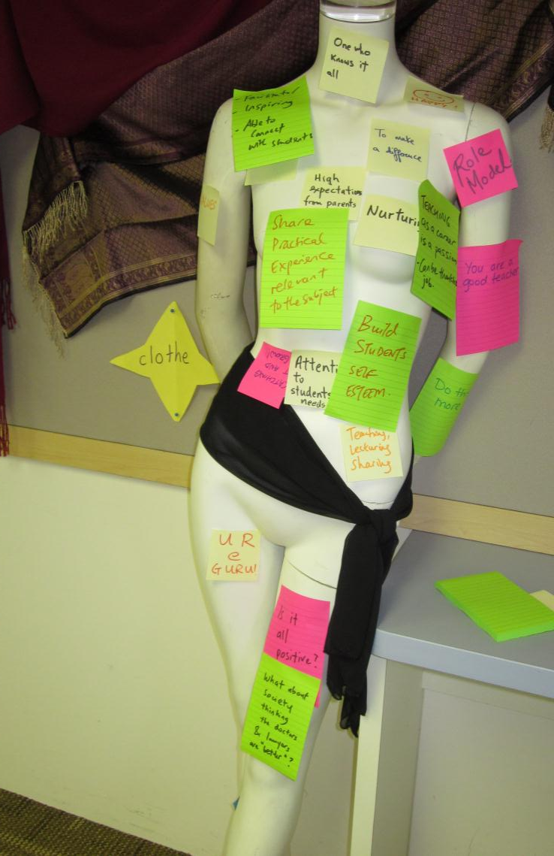
What are the expectations of others about teachers?

Slide 26
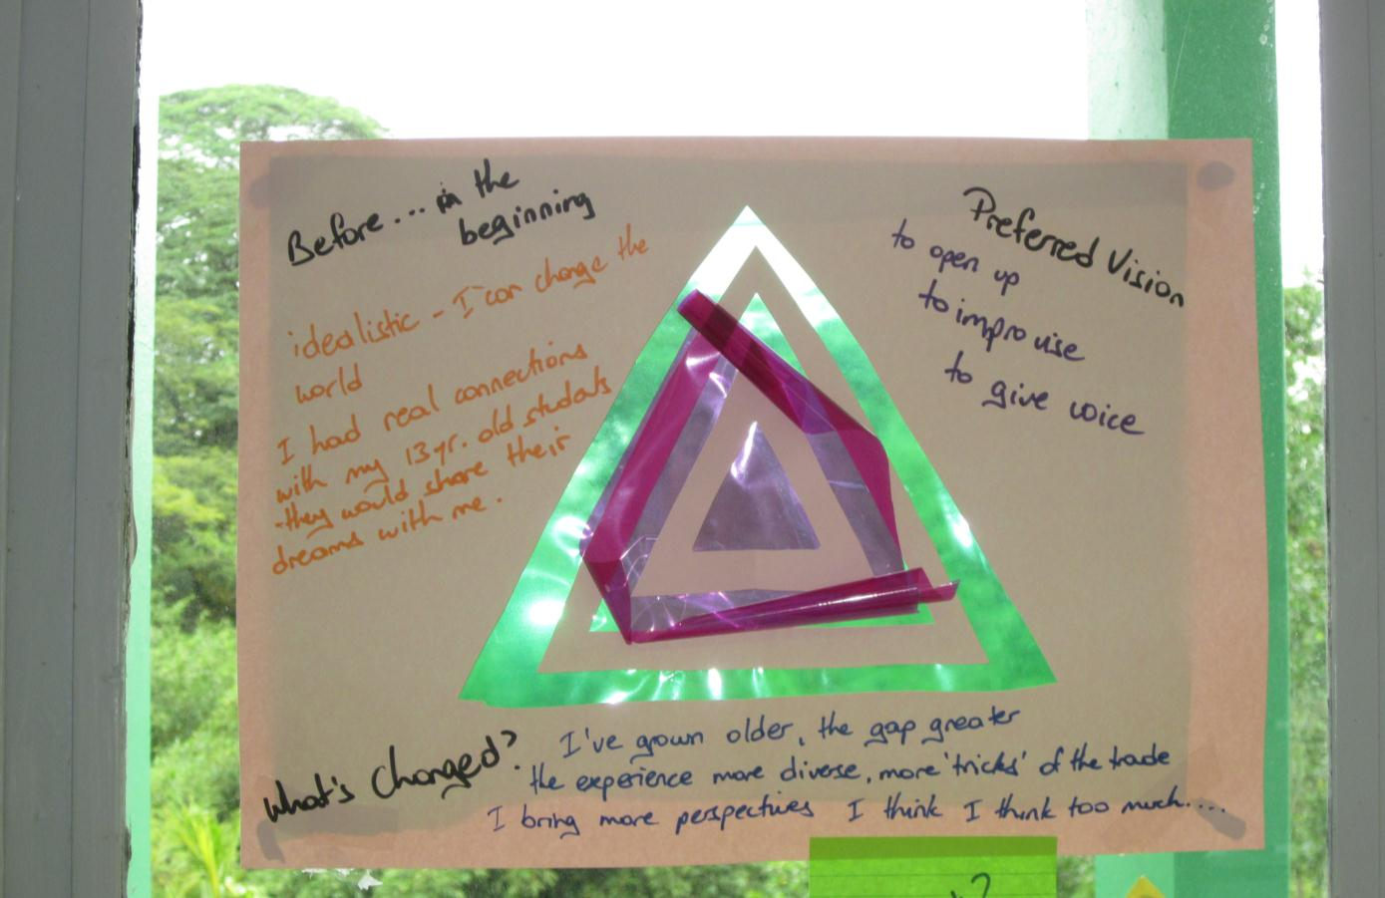
What was your vision before teaching?
What is your vision now? What has changed?

Slide 27
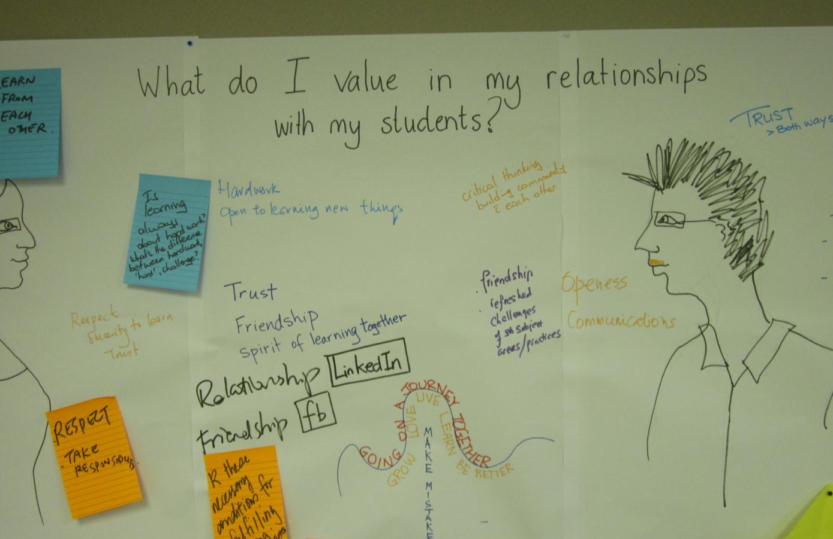
What do I value in my relationships with my students?

Slide 28
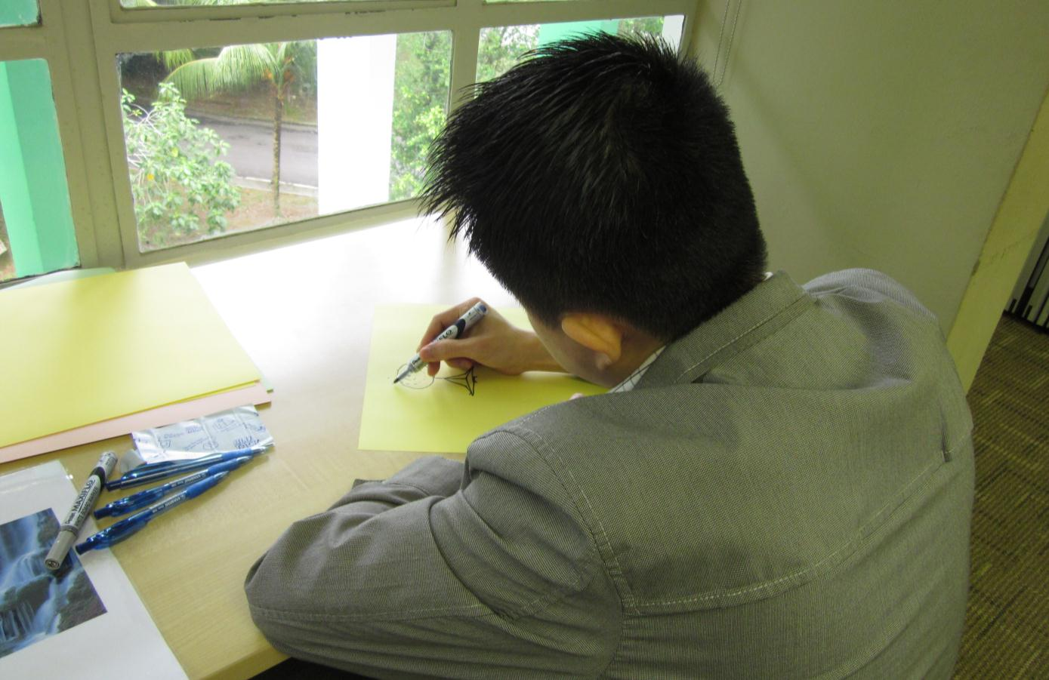
What questions do you have about teaching and learning?

Slide 29
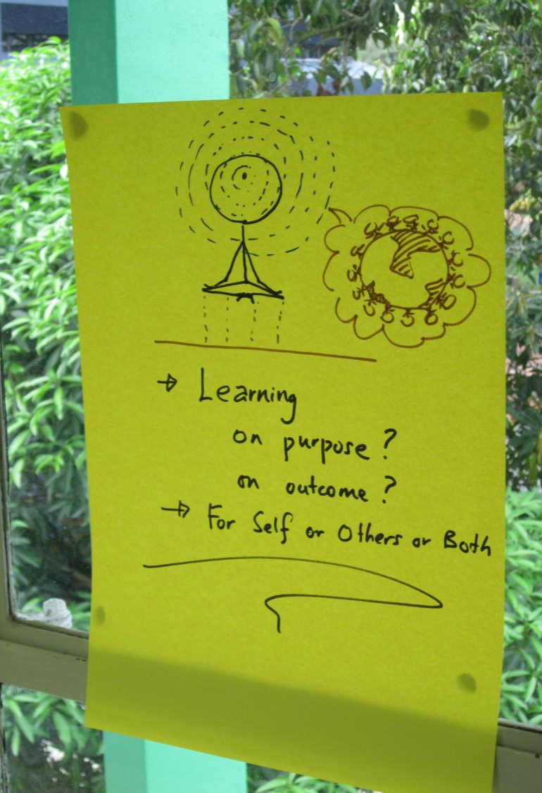
What questions do you have about teaching and learning?

Slide 30
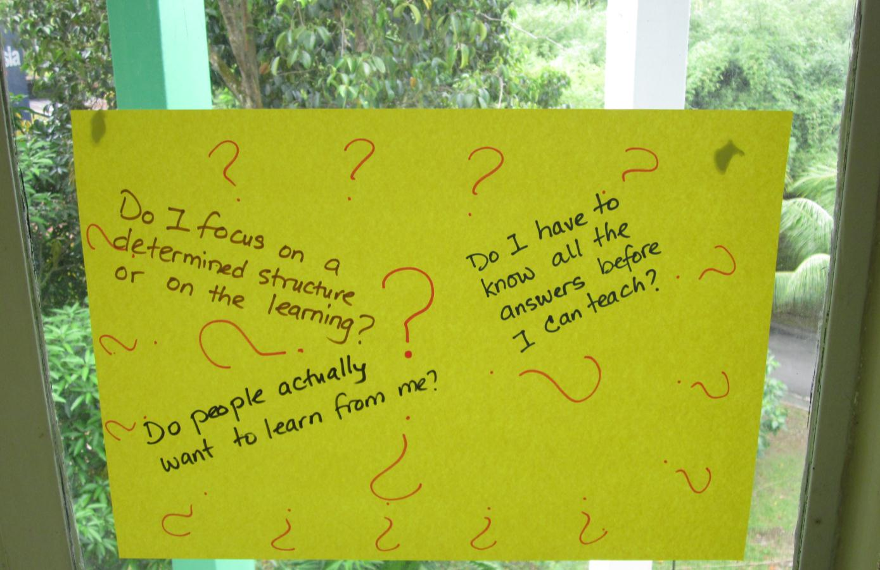
What questions do you have about teaching and learning?

Slide 31
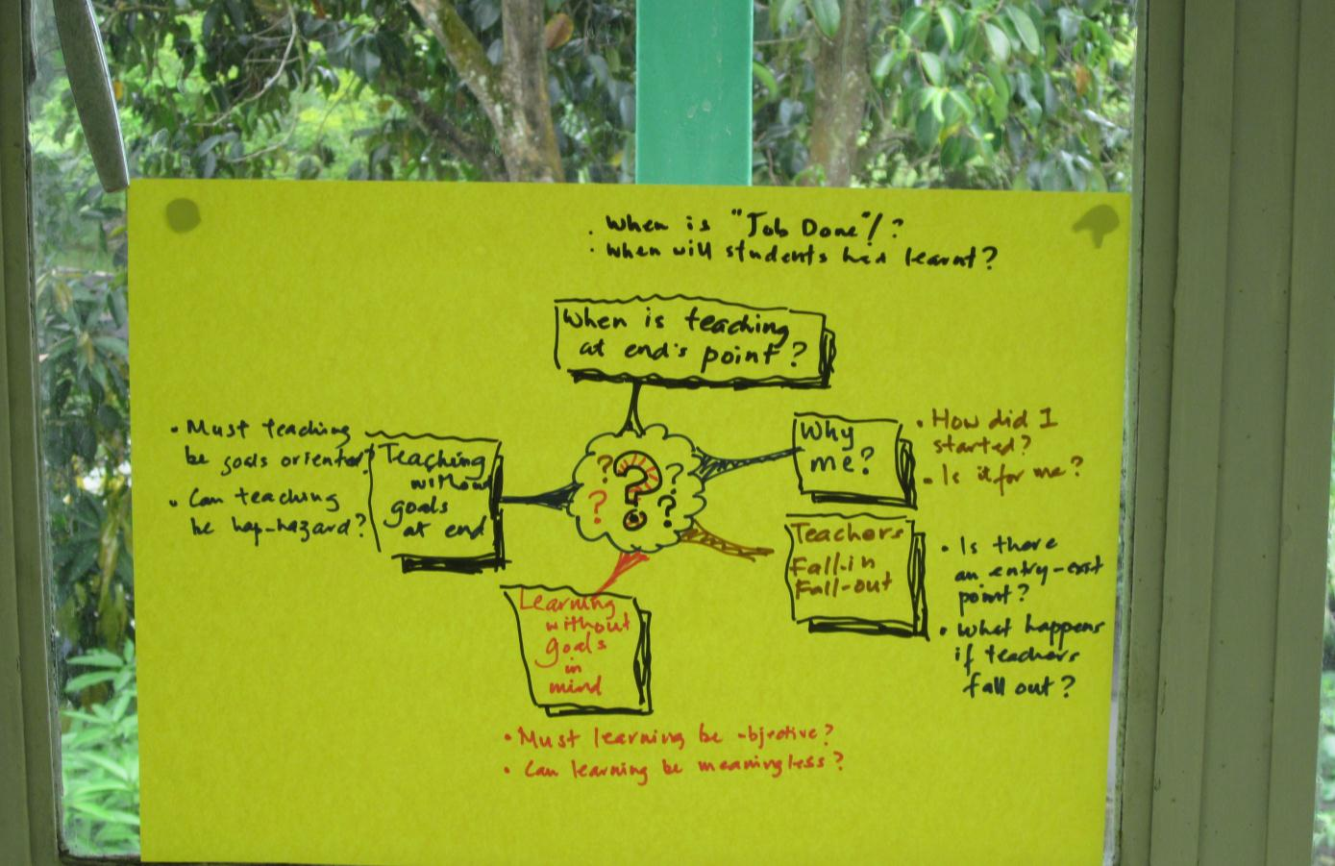
What are your questions about teaching and learning?

Slide 32
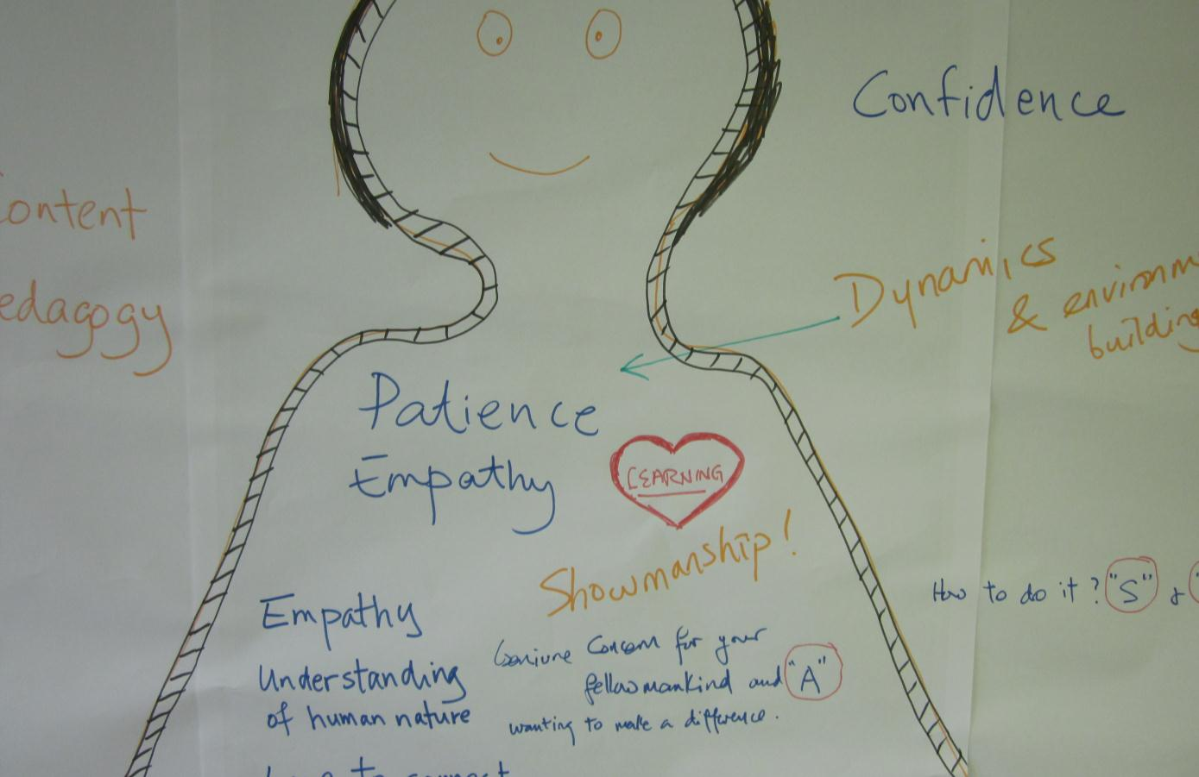
Inside the person put the qualities you think good teachers have to be born with.
Put outside those things that can be taught.

Slide 33
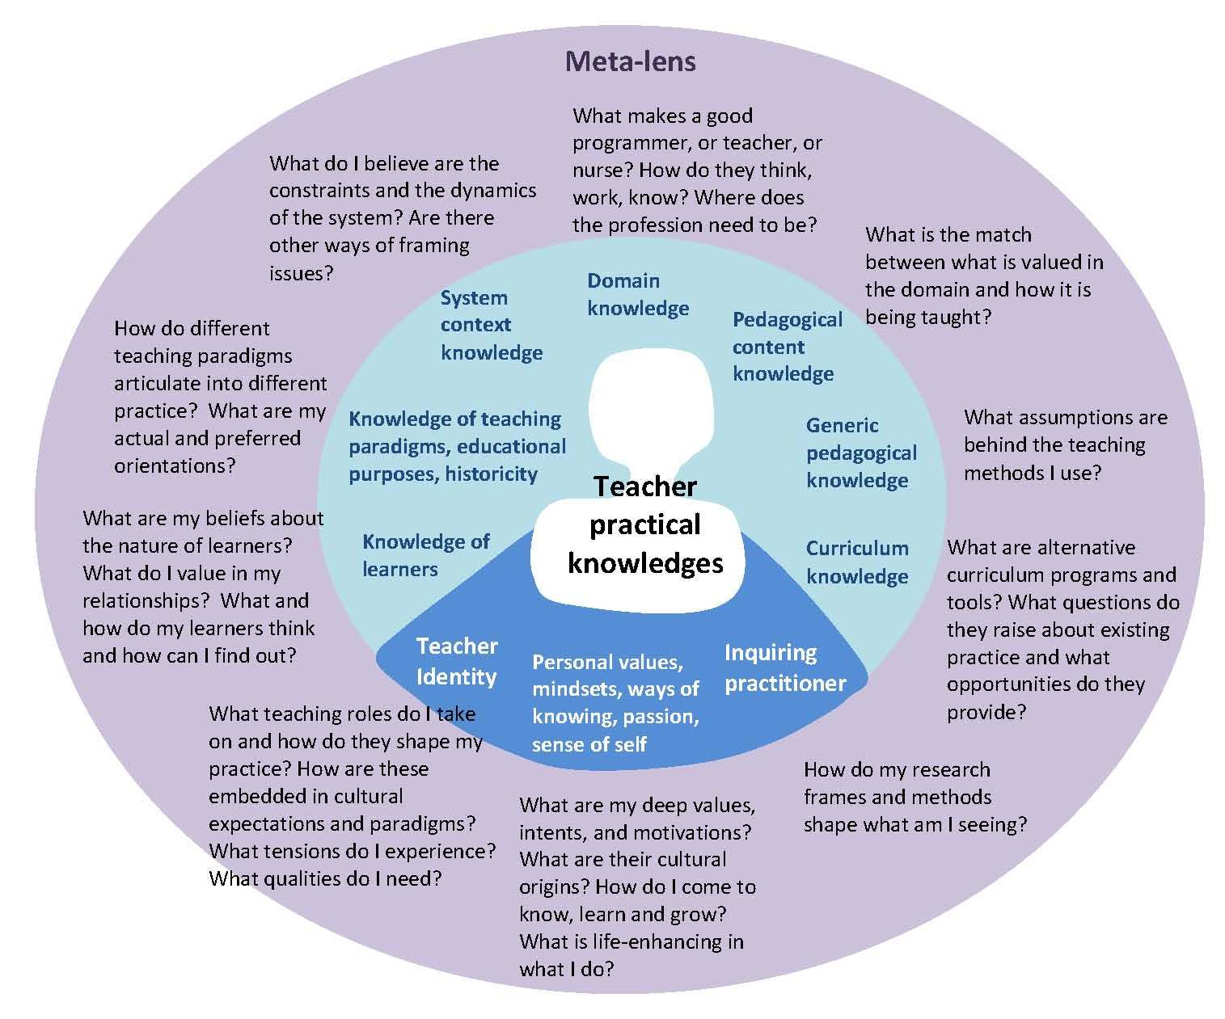
This ecology room was designed to make more visible the tacit “Teacher Knowledges” that we have.

Slide 34
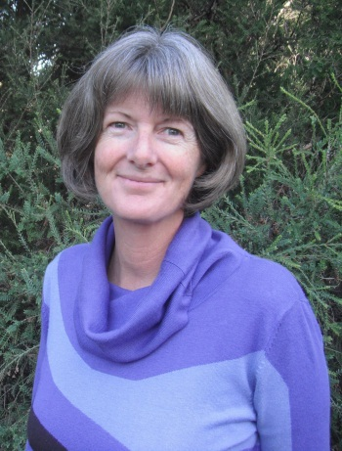

Acknowledgements
The “ecology room” concept is the brainchild of Dr Sue Stack.
Susan.Stack@utas.edu.au
Many thanks to the participants of The ‘Who’ of Teaching workshop for allowing their work to be shared.

